Slide 1
Modeling the evolution of the mutation rate
Yoav ram
Hadany Lab
Life sciences faculty
Tel-aviv University
10 March 2014

Slide 2



Variability in mutation rates
Between species
Rates are in average number of measurable mutations per genome per generation
Flies: 0.455
Keightley et al. Gen Res 2009
Humans: 41
Lynch, PNAS 2010
Bacteria: 0.0004
Wielgoss et al. G3 2011
2

Slide 3
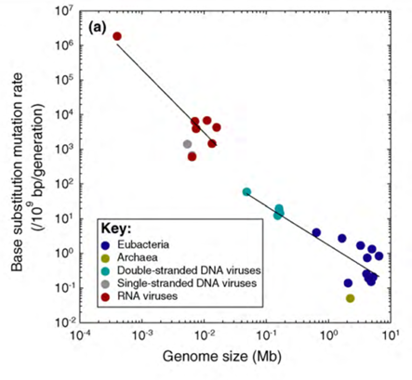
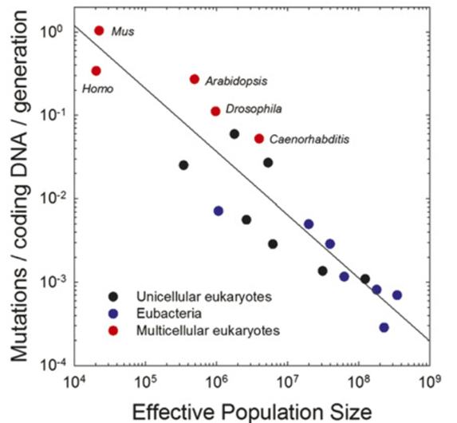
Non-adaptive hypotheses
Genome size (Mb)
Effective population size
Sung et al. PNAS 2012

Slide 4
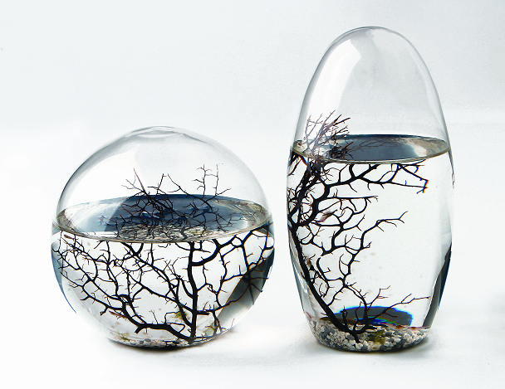
Evolution in a static environment

Slide 5
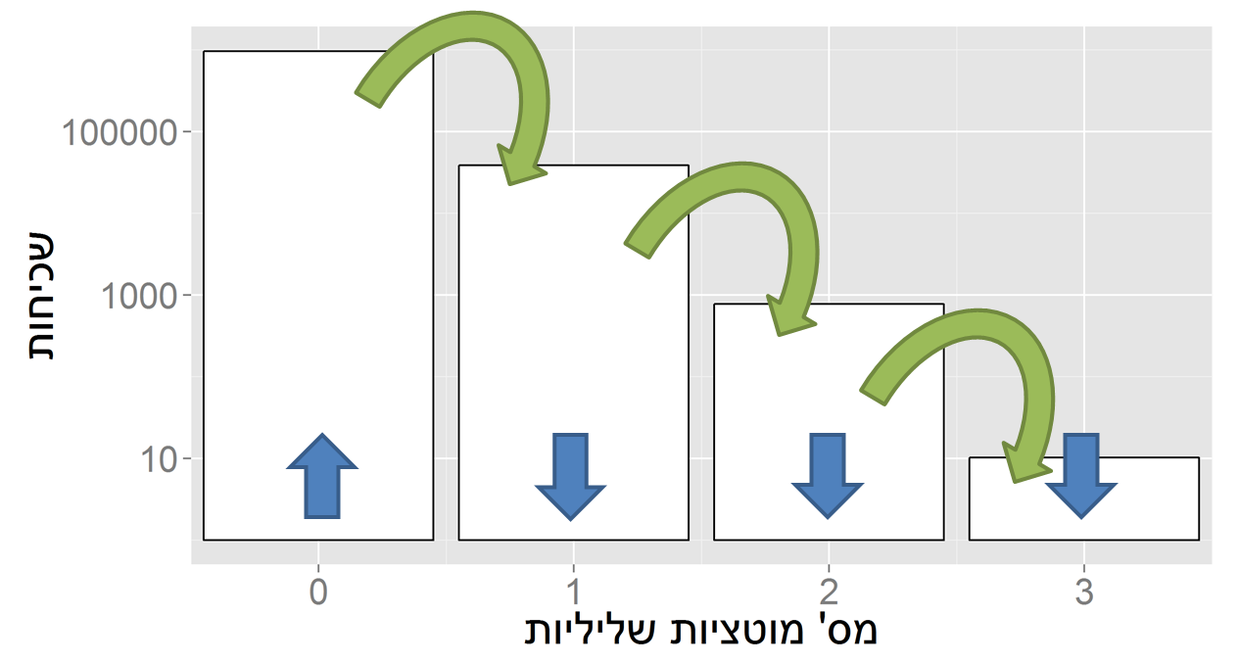
Evolution in a static environment
Directional selection without change
A balance between mutation and natural selection
Frequency
# Deleterious mutations

Slide 6
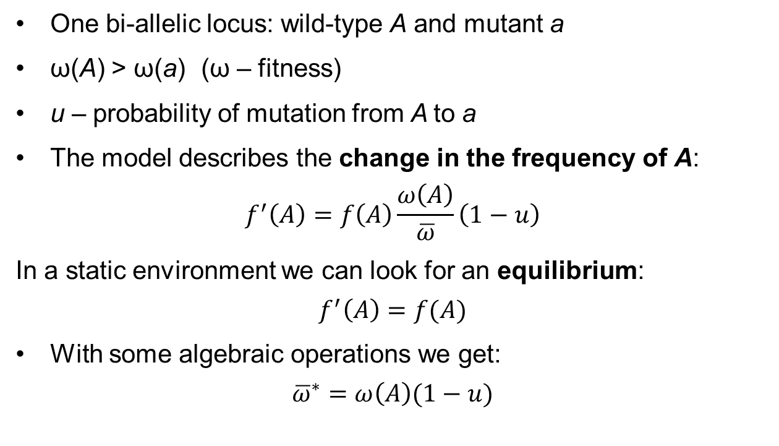
Single locus model
One bi-allelic locus: wild-type A and mutant a
ω(A) > ω(a) (ω – fitness)
u – probability of mutation from A to a
The model describes the change in the frequency of A:
$$f^{′}\left(A\right)=f\left(A\right)\frac{ω\left(A\right)}{\overline{ω}}\left(1−u\right)$$
In a static environment we can look for an equilibrium:
$$f^{′}\left(A\right)=f(A)$$
With some algebraic operations we get:
$${\overline{ω}}^{∗}=ω\left(A\right)(1−u)$$

Slide 7
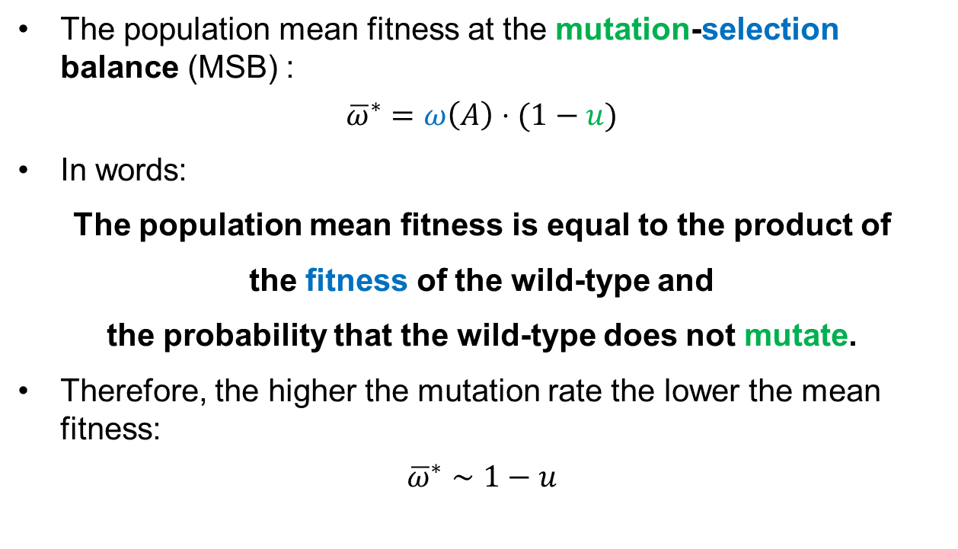
Single locus MSB
The population mean fitness at the mutation-selection balance (MSB) :
$${\overline{ω}}^{∗}=ω\left(A\right)⋅(1−u)$$
In words:
The population mean fitness is equal to the product of
the fitness of the wild-type and
the probability that the wild-type does not mutate.
Therefore, the higher the mutation rate the lower the mean fitness:
$${\overline{ω}}^{∗}∼1−u$$

Slide 8
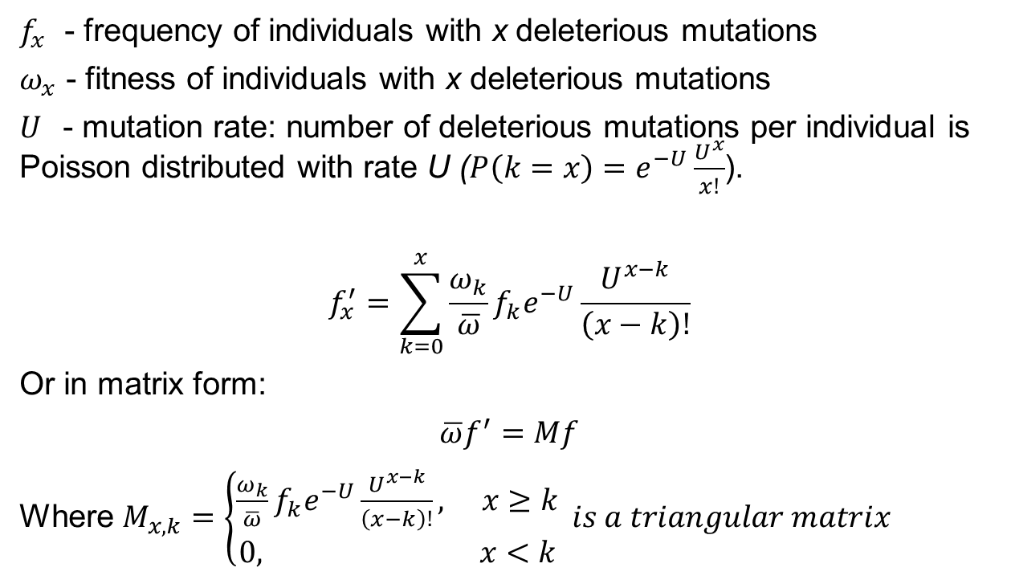
Multiple locus MSB
$f_{x}$ - frequency of individuals with x deleterious mutations
$ω_{x}$ - fitness of individuals with x deleterious mutations
$U$- mutation rate: number of deleterious mutations per individual is Poisson distributed with rate U ($P\left(k=x\right)=e^{−U}\frac{U^{x}}{x!}$).
$$f_{x}^{′}=\sum_{k=0}^{x}{\frac{ω_{k}}{\overline{ω}}f_{k}e^{−U}\frac{U^{x−k}}{\left(x−k\right)!}}$$
Or in matrix form:
$$\overline{ω}f^{′}=Mf$$
Where $M_{x,k}=\left\{\begin{aligned}\frac{ω_{k}}{\overline{ω}}f_{k}e^{−U}\frac{U^{x−k}}{\left(x−k\right)!}, x≥k \\ 0, x<k\end{aligned}\right. is a triangular matrix$

Slide 9

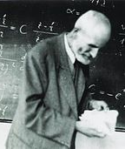
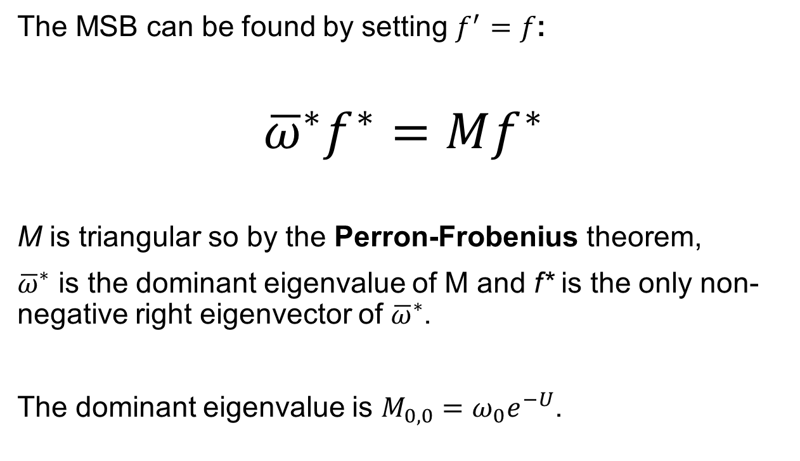
Multiple locus MSB
The MSB can be found by setting $f^{′}=f$:
$${\overline{ω}}^{∗}f^{∗}=Mf^{∗}$$
M is triangular so by the Perron-Frobenius theorem,
${\overline{ω}}^{∗}$ is the dominant eigenvalue of M and f* is the only non-negative right eigenvector of ${\overline{ω}}^{∗}$.
The dominant eigenvalue is $M_{0,0}=ω_{0}e^{−U}$.
Ferdinand G. Frobenius
1849-1917, Germany
Oskar Perron
1880-1975, Germany

Slide 10
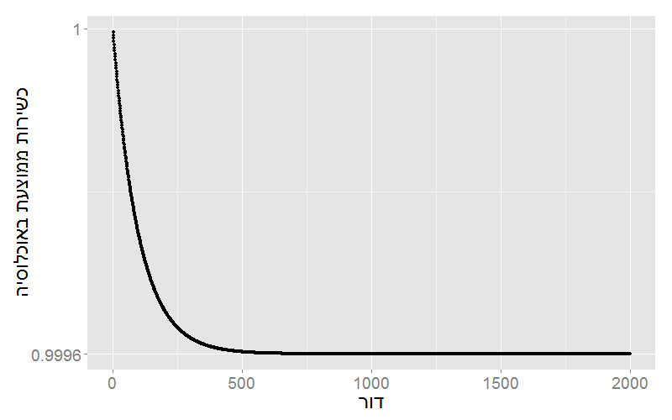
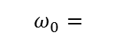
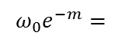
Simulation results
$$ω_{0}=$$
Population mean fitness
$$ω_{0}e^{−m}=$$
Generations

Slide 11

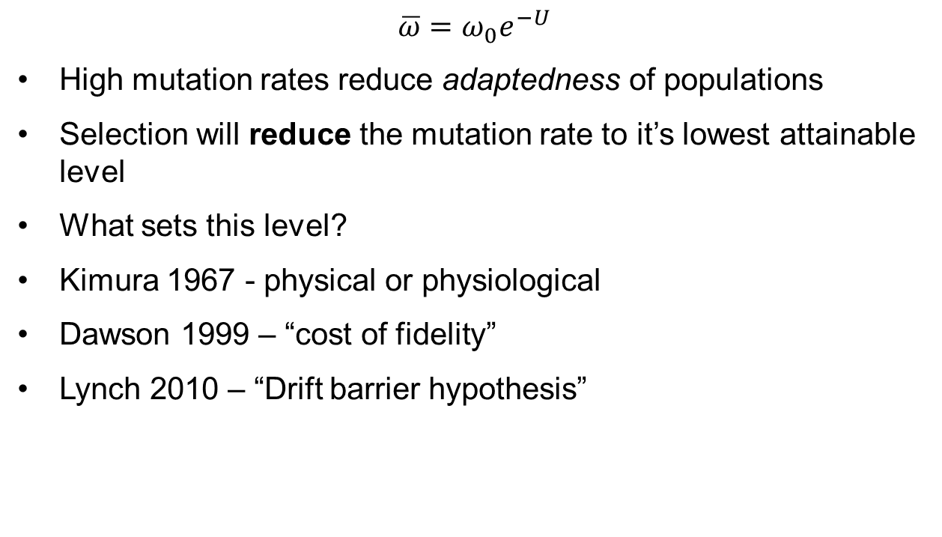
Mutation rate in static environments
$$\overline{ω}=ω_{0}e^{−U}$$
High mutation rates reduce adaptedness of populations
Selection will reduce the mutation rate to it’s lowest attainable level
What sets this level?
Kimura 1967 - physical or physiological
Dawson 1999 – “cost of fidelity”
Lynch 2010 – “Drift barrier hypothesis”
Sung et al. PNAS 2012

Slide 12

Evolution in a dynamic environment
In changing environments rapid adaptation can be favored by natural selection (adaptability)
The mutation rate must balance between adaptability and adaptedness

Slide 13

Mutators in oscillating environments
Model: Leigh, Am Nat 1970
Fitness locus with alleles A and a like before
The environmental changes every n generations
When it changes, fitness(A) < fitness(a) and vice versa
The optimal mutation rate is 1/n
For n=1,000 the mutation rate is 10⁻³
Very high the rate of mutation per gene
Egbert Giles Leigh, Jr.
Smithsonian Tropical Research Institute - Panama

Slide 14
Mutators in oscillating environments
The optimal mutation rate is now 1/n
MSB model -> n is large -> slowly changing environments
Selection for the standing variation generated by mutators
Local mutators? Same n for all loci? Averaging on all loci?

Slide 15

Variability in mutation rates
Within species
Mutation rate in 69 natural populations of E. coli – Matic et al. 1997

Slide 16

Mutators in adaptive evolution
Model: Taddei et al., Nature 1997
Multiple-locus simulations
Single environmental change
No standing variation
Mutation at the mutator locus
E. coli

Slide 17
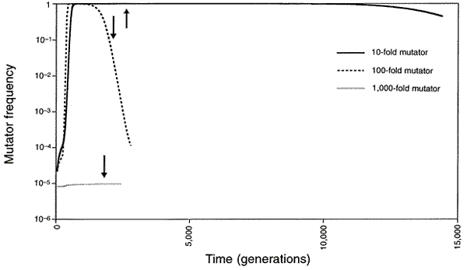
Rise and fall of the mutator allele
x10
x100
x1,000
Taddei, et al. Nature 1997
Notes:
An arrow symbolizes the time when population fitness has reached 0.99

Slide 18

Variability in mutation rates
Within individuals
DNA polymerase error rate – Lynch 2011

Slide 19

Stress-induced mutation
Rosenberg et al. 2012
In E. coli:
Error prone polymerase induced by stress responses:
SOS response
DNA damage
Starvation
Mismatch repair system
Other mechanisms:
Galhardo et al. 2007
Al Mamun, Science 2012

Slide 20

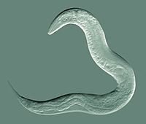
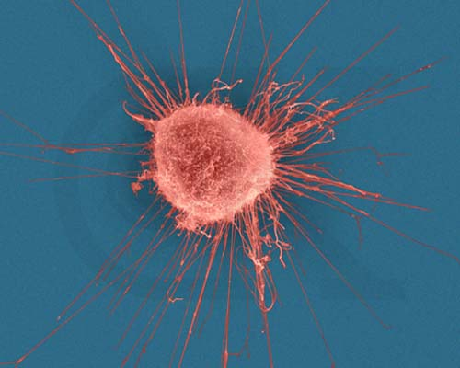



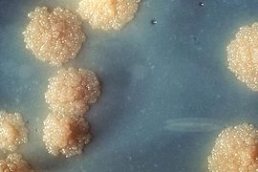

Evidence
Green algea
Nematodes
E. coli
Bacillus subtilis
Breast cancer cell
D. Melanogaster
M. tuberculosis
L. monocytogenes

Slide 21

Evolution of stress-induced mutation
Null hypothesis
Mutagenesis is the by-product of stress
Alternative non-adaptive hypotheses
Cost of fidelity
Drift barrier hypothesis
Adaptive hypothesis
Second order selection

Slide 22
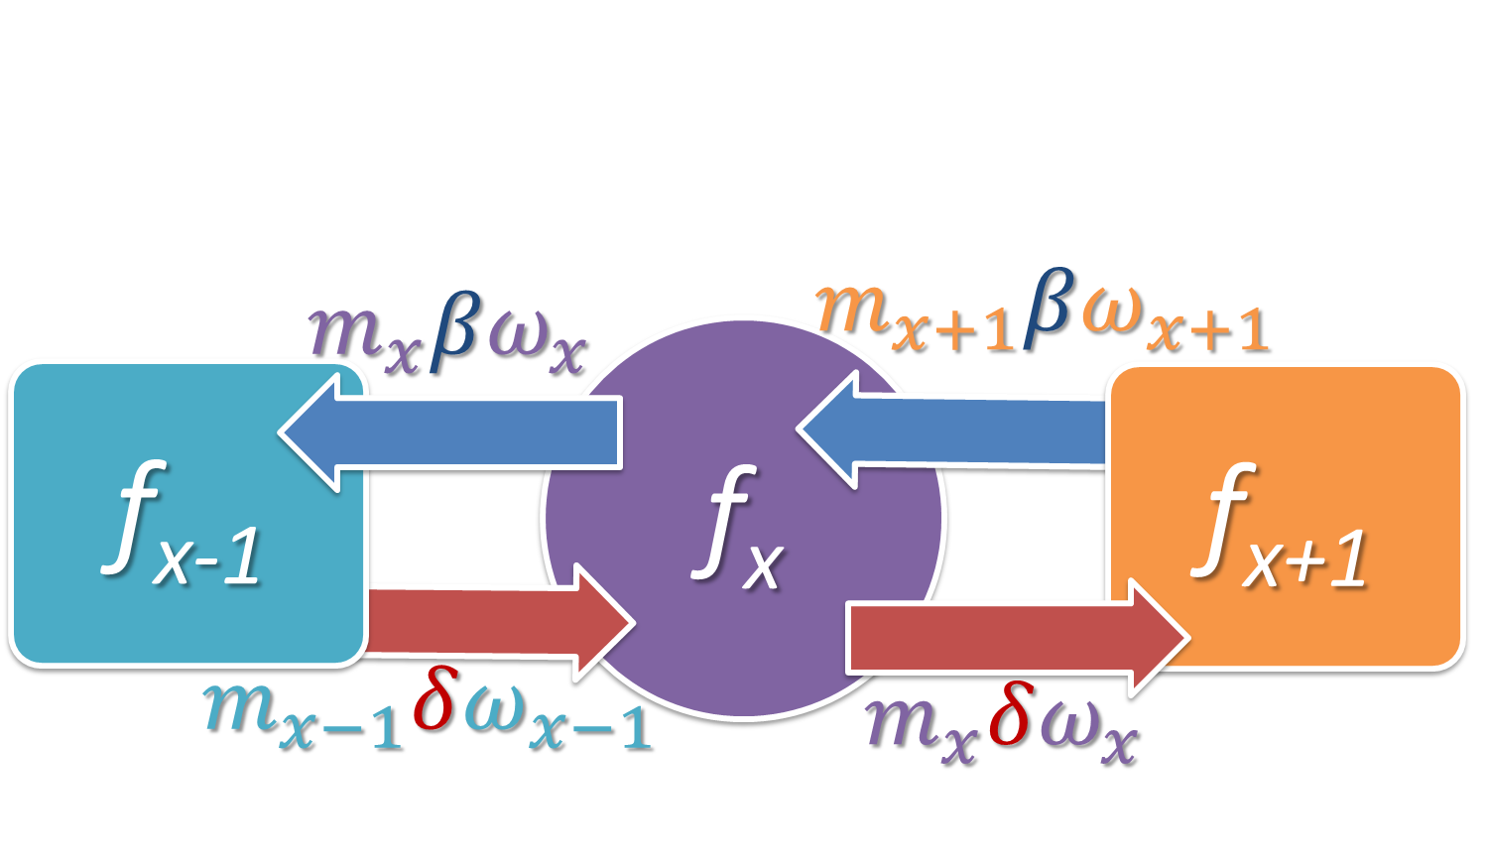
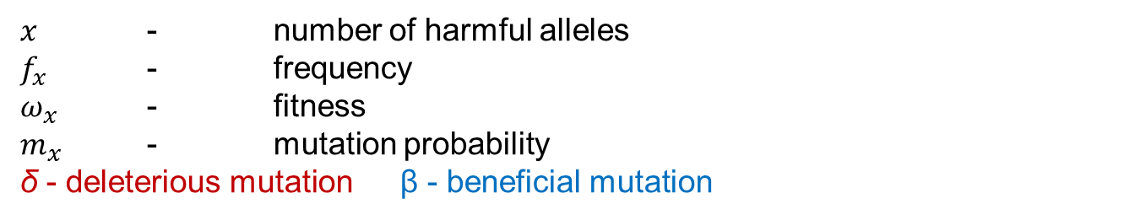
Static environment
Selection against generation of deleterious mutations
$x$ - number of harmful alleles
$f_{x}$ - frequency
$ω_{x}$ - fitness
$m_{x}$ - mutation probability
δ - deleterious mutation β - beneficial mutation

Slide 23
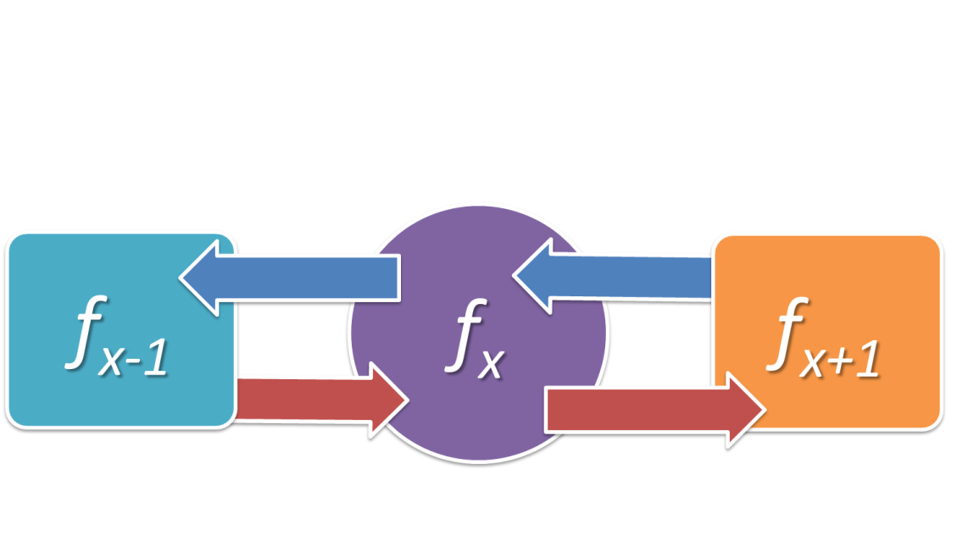
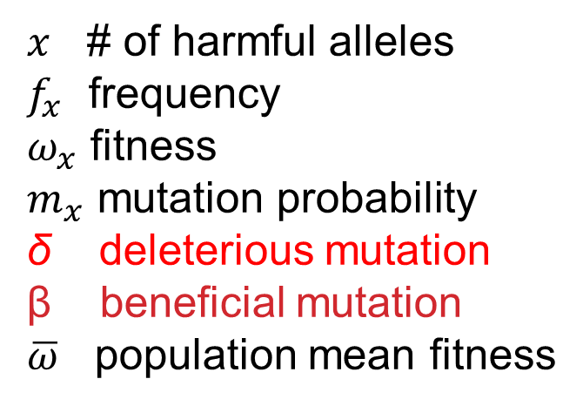
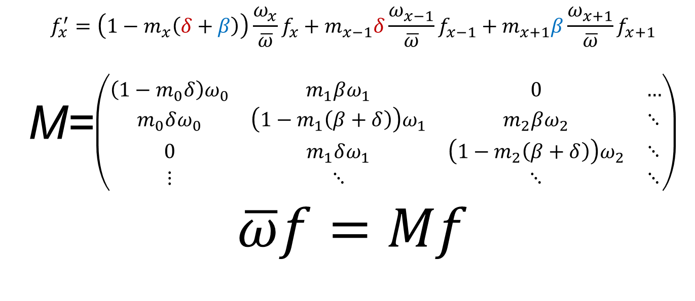
$x$ # of harmful alleles
$f_{x}$ frequency
$ω_{x}$ fitness
$m_{x}$ mutation probability
δ deleterious mutation
β beneficial mutation
$\overline{ω}$ population mean fitness
$$f_{x}^{′}=\left(1−m_{x}\left(δ+β\right)\right)\frac{ω_{x}}{\overline{ω}}f_{x}+m_{x−1}δ\frac{ω_{x−1}}{\overline{ω}}f_{x−1}+m_{x+1}β\frac{ω_{x+1}}{\overline{ω}}f_{x+1}$$
M=$\left(\begin{matrix}\left(1−m_{0}δ\right)ω_{0} & m_{1}βω_{1} & 0 & … \\ m_{0}δω_{0} & \left(1−m_{1}\left(β+δ\right)\right)ω_{1} & m_{2}βω_{2} & ⋱ \\ 0 & m_{1}δω_{1} & \left(1−m_{2}\left(β+δ\right)\right)ω_{2} & ⋱ \\ ⋮ & ⋱ & ⋱ & ⋱\end{matrix}\right)$
$$\overline{ω}f=Mf$$

Slide 24
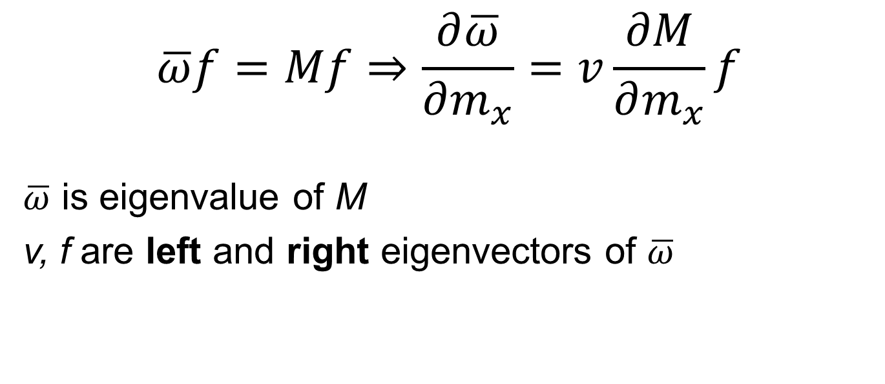
$x$ # of harmful alleles
$f_{x}$ frequency
$ω_{x}$ fitness
$m_{x}$ mutation probability
δ deleterious mutation
β beneficial mutation
$\overline{ω}$ population mean fitness
$$\overline{ω}f=Mf⇒\frac{∂\overline{ω}}{∂m_{x}}=v\frac{∂M}{∂m_{x}}f$$
$\overline{ω}$ is eigenvalue of M
v, f are left and right eigenvectors of $\overline{ω}$

Slide 25
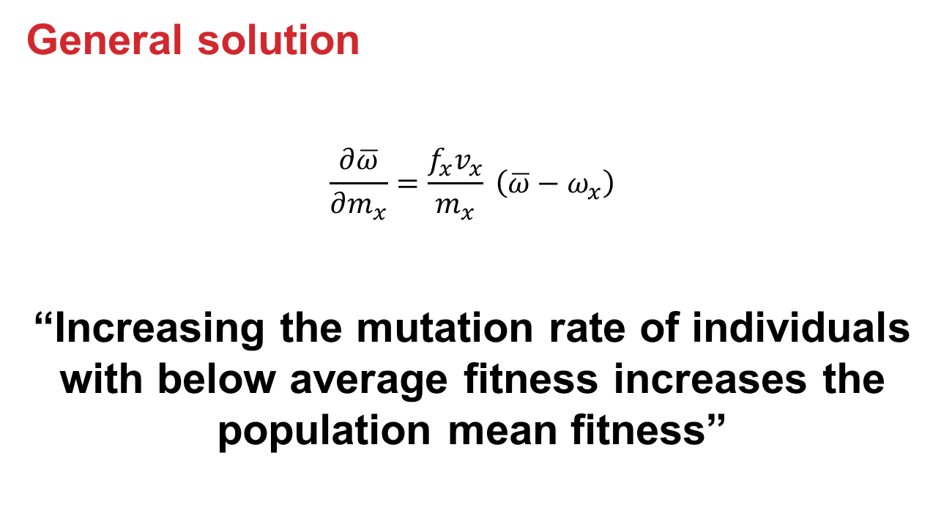
Static environment
General solution
$$\frac{∂\overline{ω}}{∂m_{x}}=\frac{f_{x}v_{x}}{m_{x}} \left(\overline{ω}−ω_{x}\right)$$
“Increasing the mutation rate of individuals with below average fitness increases the population mean fitness”

Slide 26
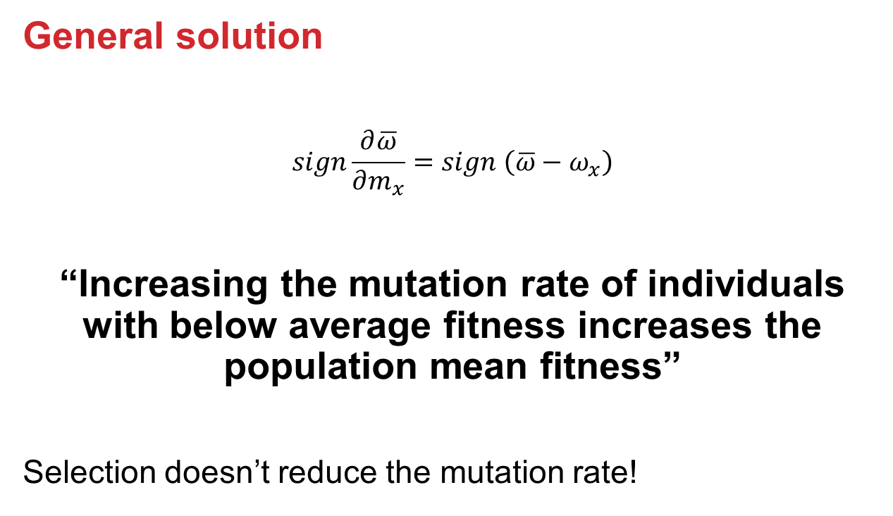
Static environment
General solution
$$sign\frac{∂\overline{ω}}{∂m_{x}}=sign \left(\overline{ω}−ω_{x}\right)$$
“Increasing the mutation rate of individuals with below average fitness increases the population mean fitness”
Selection doesn’t reduce the mutation rate!

Slide 27

Static environments
Constitutive mutator (CM)

Slide 28

Static environments
Stress-induced mutator (SIM)

Slide 29

Rapidly changing environments
The Red Queen hypothesis
- van Valen, 1973
“It takes all the running you can do, to keep in the same place.”
- Lewis Carrol, Through the Looking Glass
What happens when the environment changes frequently?

Slide 30
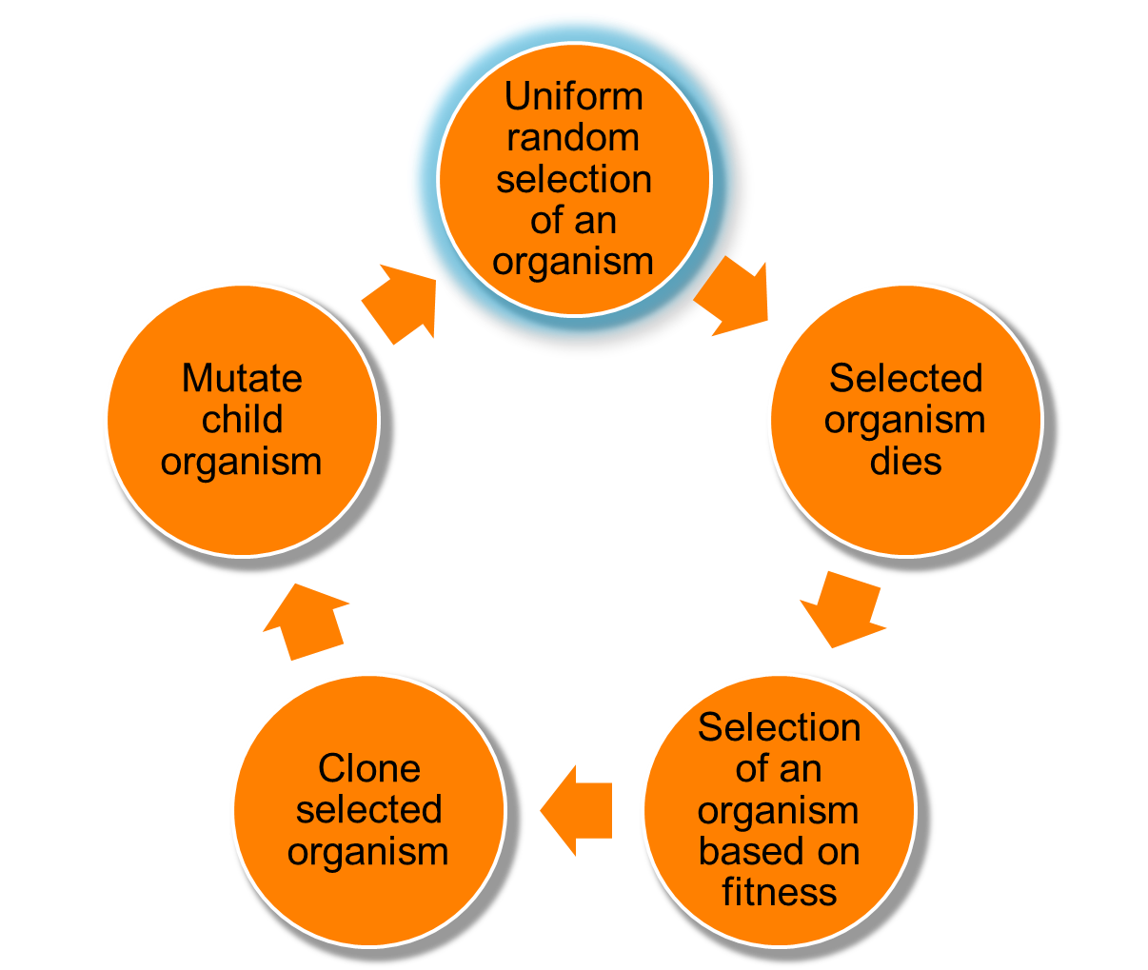
Changing environments
Simulation model
Moran process
Individual-based simulations
100,000 individuals
1,000 loci
Asexual, Haploid
Overlapping generations
No recombination
No segregation
No mutations at mutator locus
Environmental changes

Slide 31
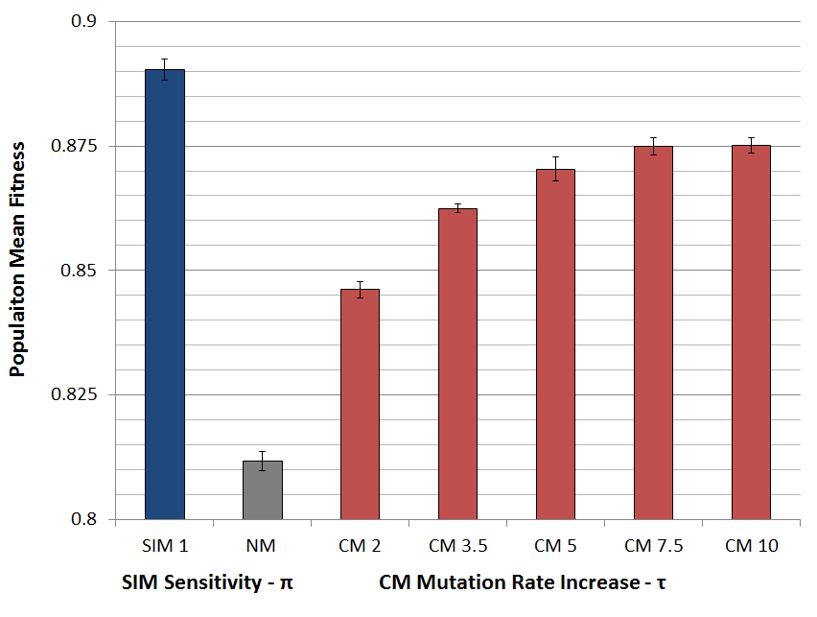
Populations with SIM are fitter

Slide 32

SIM wins competitions

Slide 33

SIM wins competitions

Slide 34
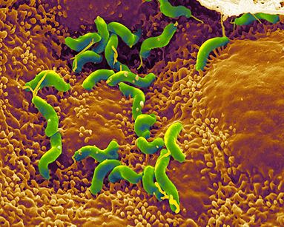
Summary: Evolution of stress-induced mutation
Stress-induced mutators evolve:
In finite & infinite populations
In constant & changing environments
Second-order selection can lead to the evolution of stress-induced mutagenesis in asexual populations
Selection for evolvability
H. pylori

Slide 35
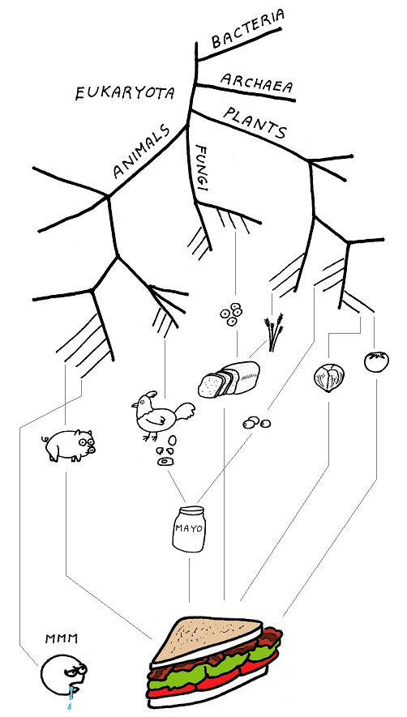
Consequences of stress-induced mutation rate
How does SIM affect evolution?

Slide 36
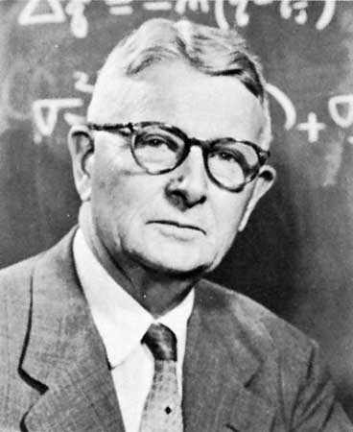
Adaptive peak shifts
This problem was introduces by Sewall Wright in 1931:
If a new adaptation requires several, separately deleterious mutations, how can it evolve?

Slide 37
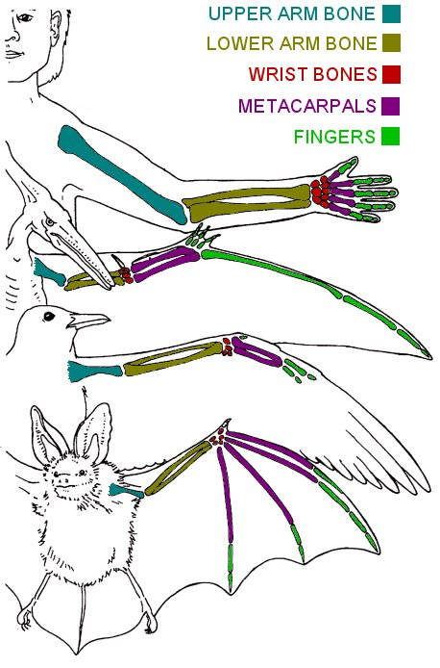
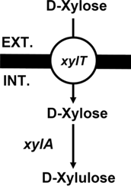
examples
Criteria
Adaptation requires a change in two or more traits
Change in only one trait causes reduced fitness
Wings and bones
Flying with heavy bones is costly
Walking and climbing with light bones is dangerous
New metabolic pathway
Two new proteins required – pump and enzyme
each is wasteful without the other
Adaptation to high UV (Haldane 1932, p. 175)
Dark skin – increased pigmentation
Vitamin D storage in the liver
Xiao et al. 2011

Slide 38
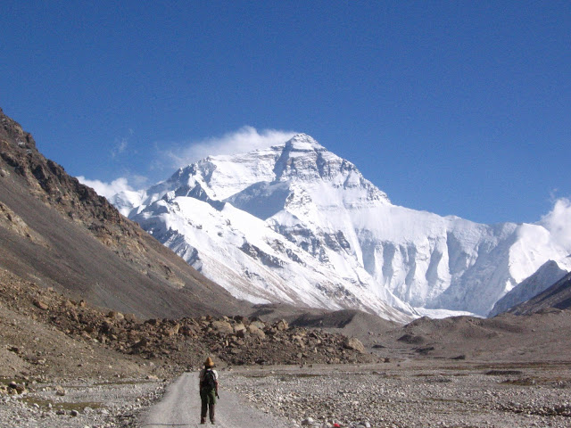
Simple landscape

Slide 39
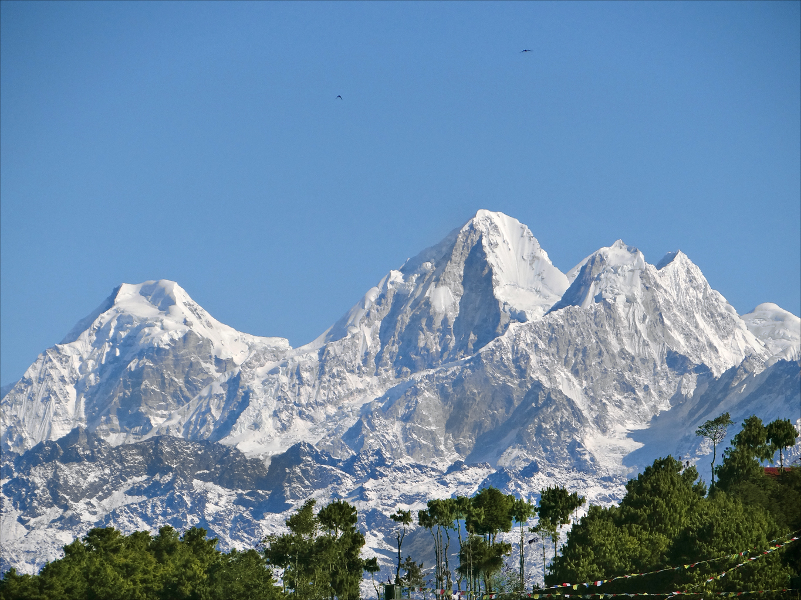
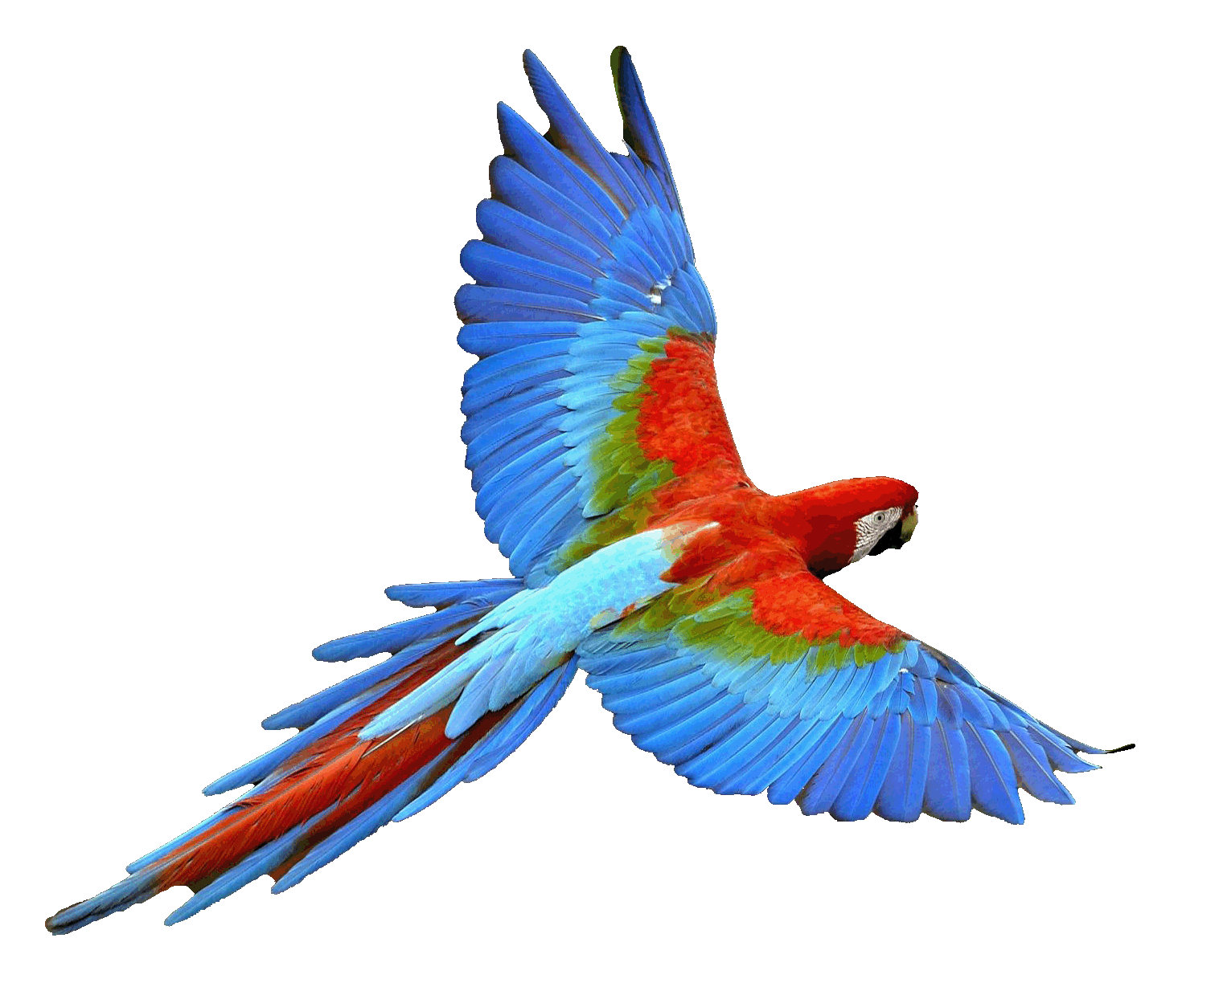
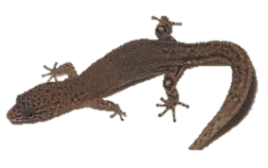
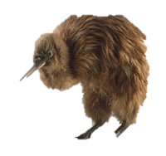
Rugged landscape
Wings
Light bones
No wings
Heavy bones
No wings
Light bones

Slide 40
Adaptive Peak shift
High peak
Low peak
Valley

Slide 41
SIM & rugged landscape
Increasing the mutation rate in individuals below both peaks
High mutation rate
Low mutation rate

Slide 42
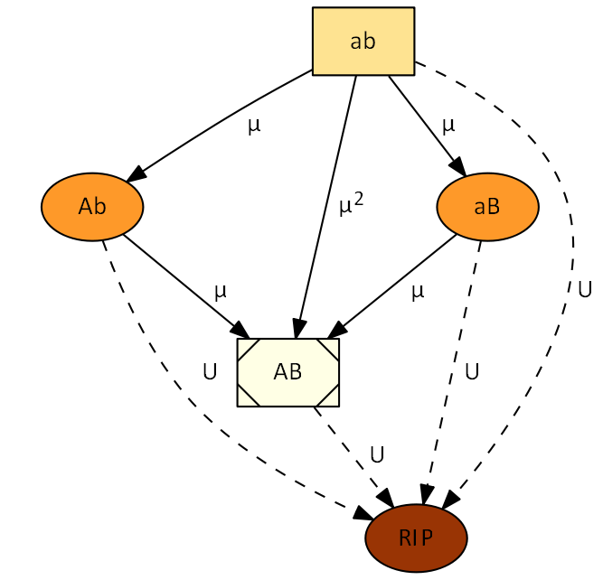
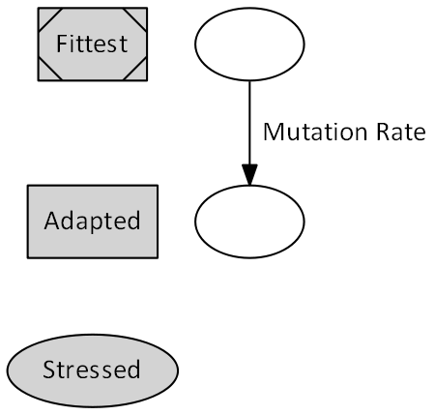


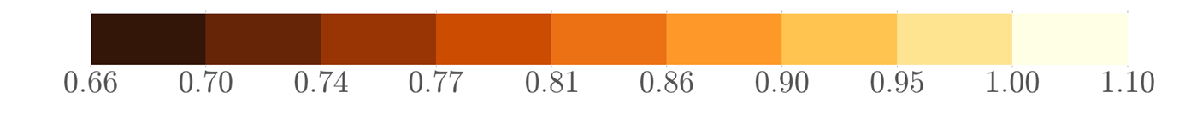
Deterministic model
fitness

Slide 43

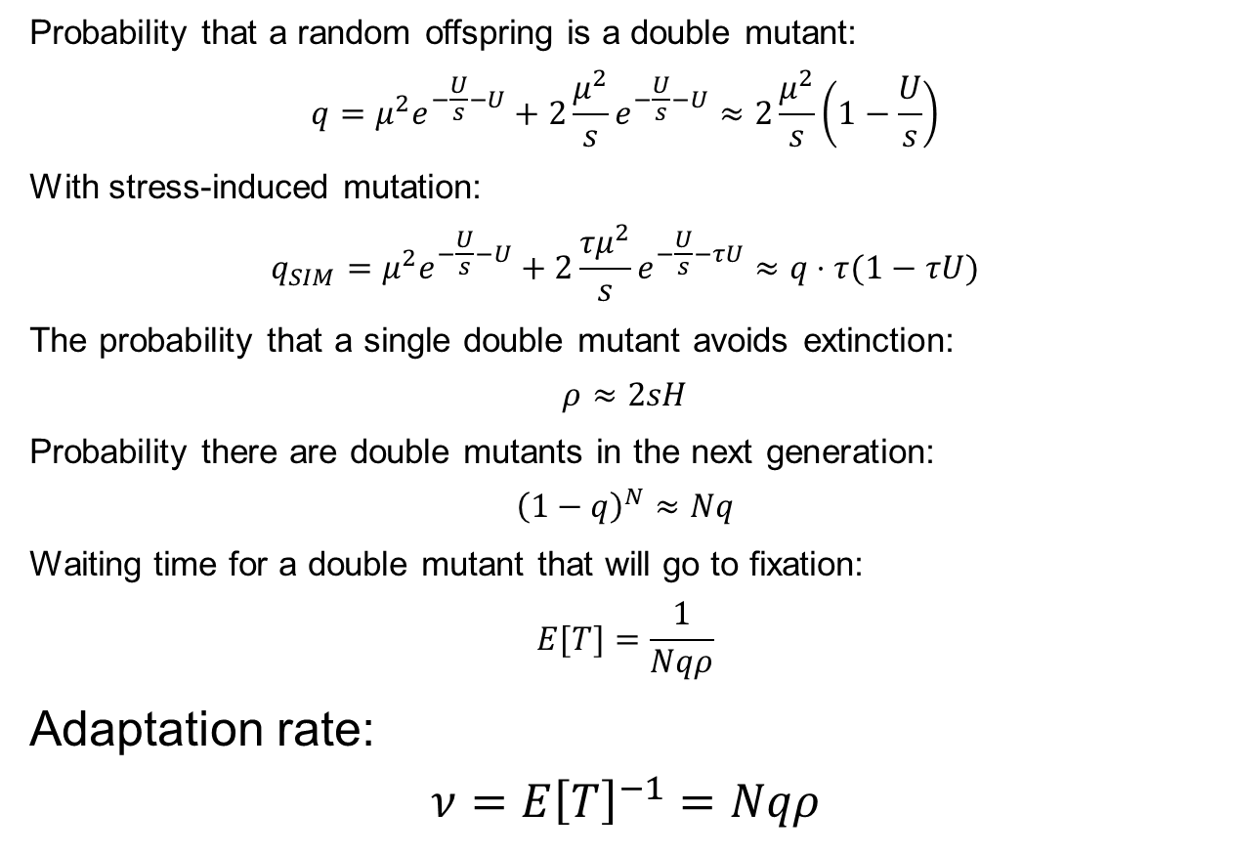
Probability that a random offspring is a double mutant:
$$q=μ^{2}e^{−\frac{U}{s}−U}+2\frac{μ^{2}}{s}e^{−\frac{U}{s}−U}≈2\frac{μ^{2}}{s}\left(1−\frac{U}{s}\right)$$
With stress-induced mutation:
$$q_{SIM}=μ^{2}e^{−\frac{U}{s}−U}+2\frac{{τμ}^{2}}{s}e^{−\frac{U}{s}−τU}≈q⋅τ(1−τU)$$
The probability that a single double mutant avoids extinction:
$$ρ≈2sH$$
Probability there are double mutants in the next generation:
$${\left(1−q\right)}^{N}≈Nq$$
Waiting time for a double mutant that will go to fixation:
$$E[T]=\frac{1}{Nqρ}$$
Adaptation rate:
$$ν=E{\left[T\right]}^{−1}=Nqρ$$
$ν$– adaptation rate; N – population size; $τ$ – mutation rate increase; $H$ – double mutant advantage; $μ$ – beneficial mutation rate

Slide 44
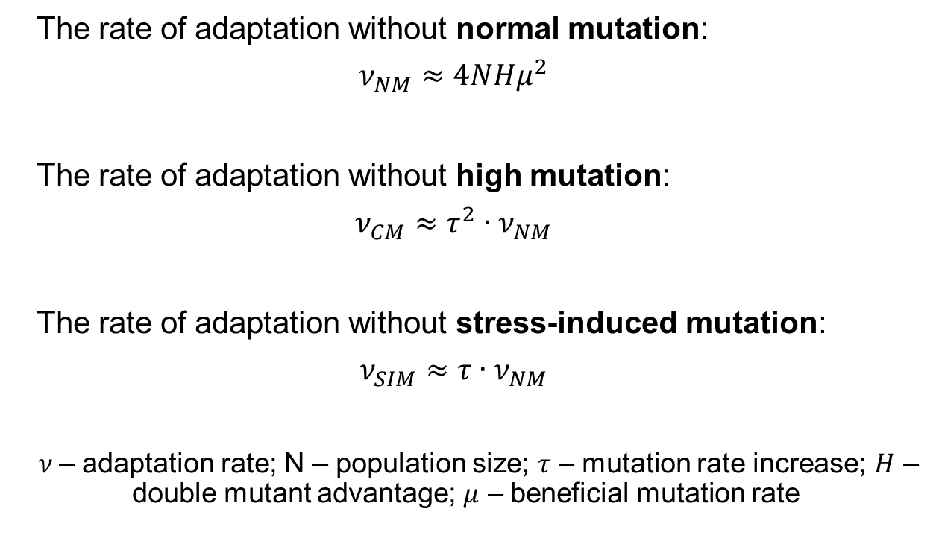
Deterministic results
The rate of adaptation without normal mutation:
$$ν_{NM}≈4NHμ^{2}$$
The rate of adaptation without high mutation:
$$ν_{CM}≈τ^{2}∙ν_{NM}$$
The rate of adaptation without stress-induced mutation:
$$ν_{SIM}≈τ∙ν_{NM}$$
$ν$– adaptation rate; N – population size; $τ$ – mutation rate increase; $H$ – double mutant advantage; $μ$ – beneficial mutation rate

Slide 45
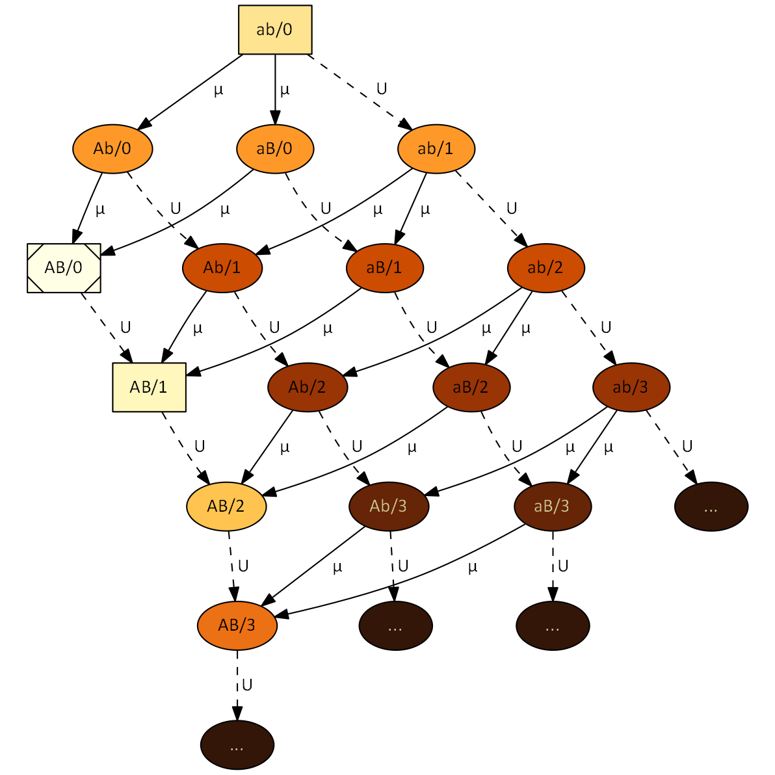


Stochastic model
No MSB assumption
No
fitness

Slide 46
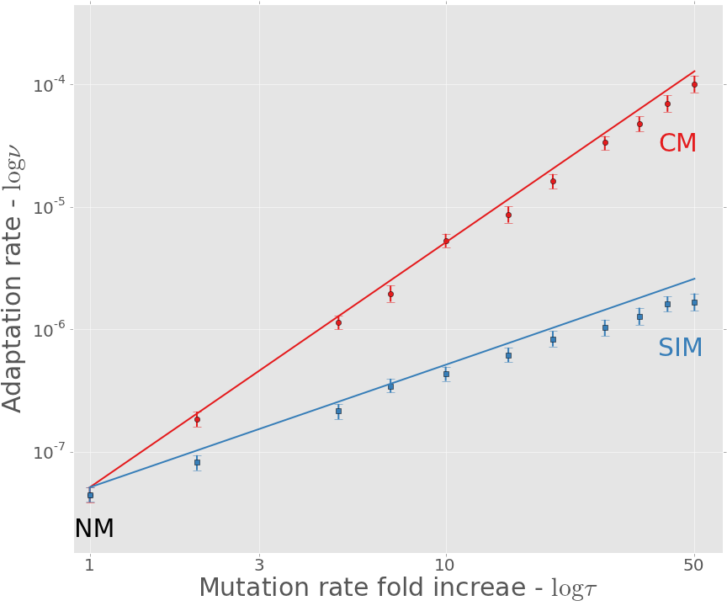
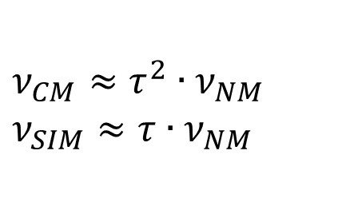
Adaptation rate
$$ν_{CM}≈τ^{2}∙ν_{NM}$$
$$ν_{SIM}≈τ∙ν_{NM}$$
Approximation
Simulation

Slide 47
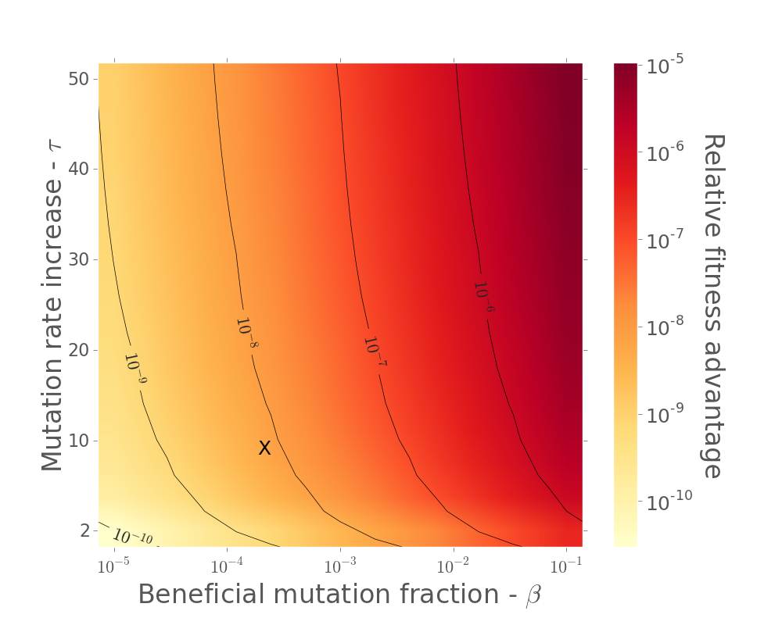
Mean fitness in MSB

Slide 48
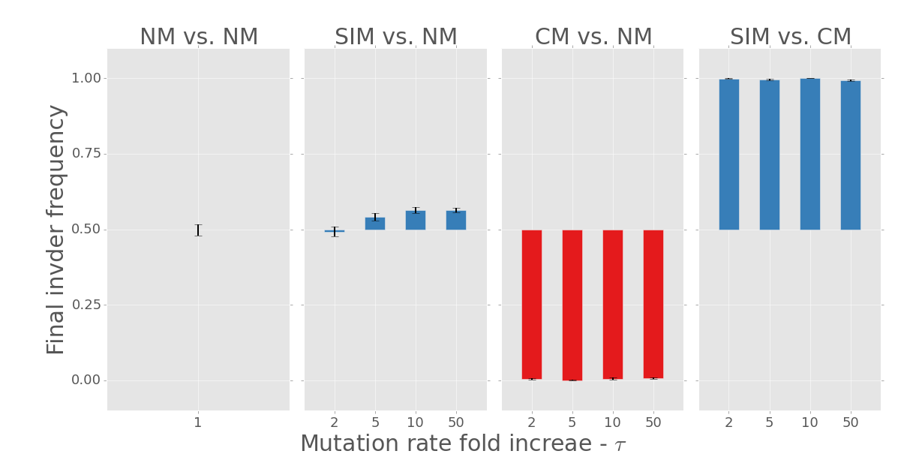
competitions

Slide 49
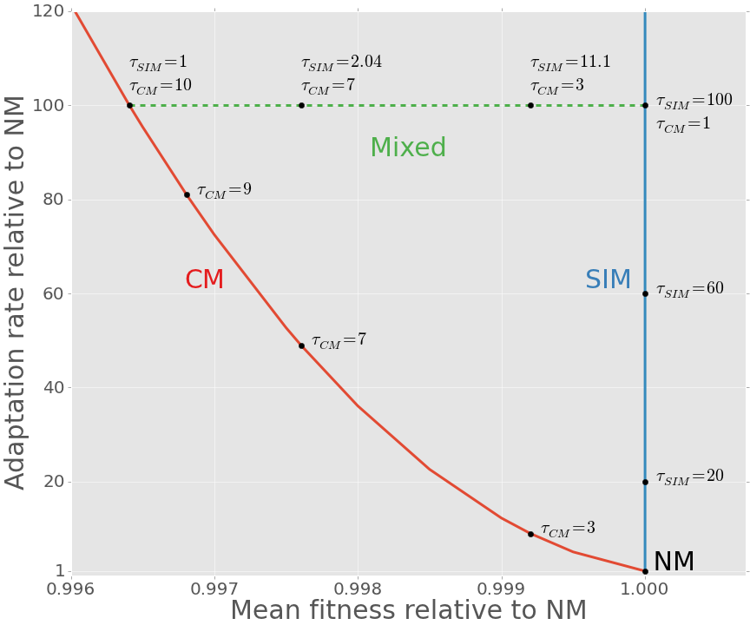
SIM Breaks the adaptability-adaptedness trade-off
Adaptability - Adaptation rate relative to NM
Adaptedness - Mean fitness relative to NM (non-mutator)

Slide 50
Conclusion
Evolution of Stress-induced mutagenesis:
SIM can evolve due to second order selection
In constant and changing environments
Effects of stress-induced mutagenesis:
SIM increases the adaptation rate without reducing the population mean fitness
Breaks the trade-off between adaptability and adaptedness

